Slide 1
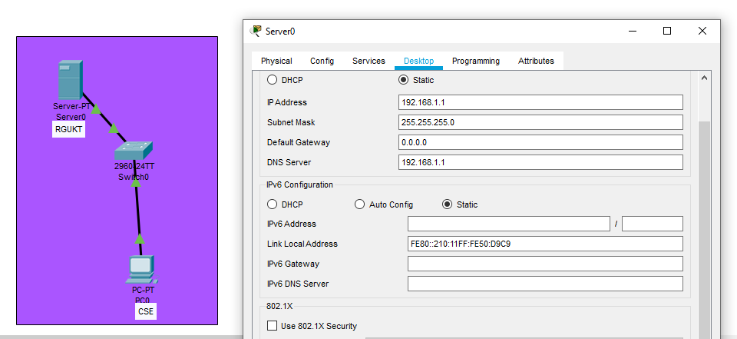
DNS server config –create server ip address and dns server address.

Slide 2
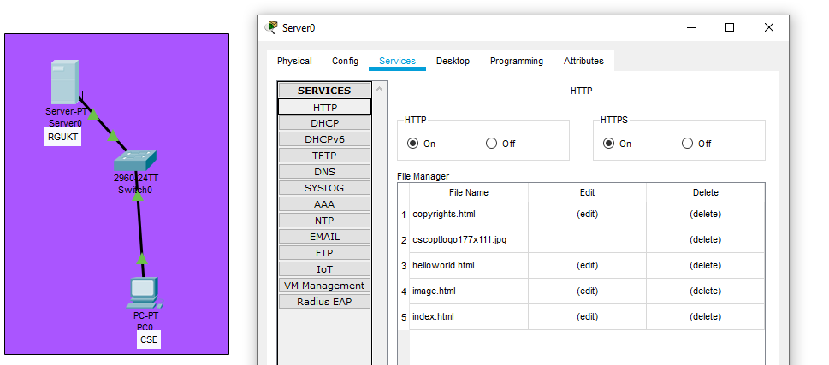
Go to server services click on HTTP and select one of index file edit

Slide 3
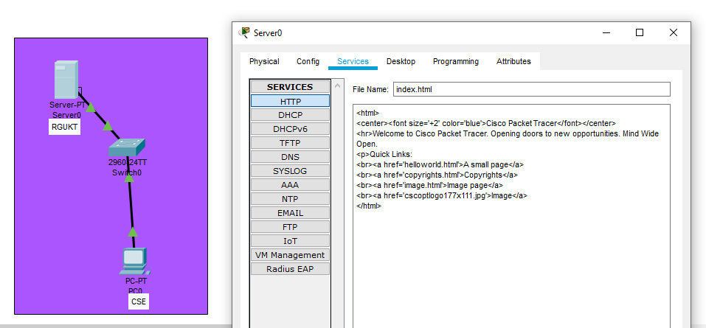
You will get html code remove the code add your code <html>your msg</html> and save it overwrite …..

Slide 4
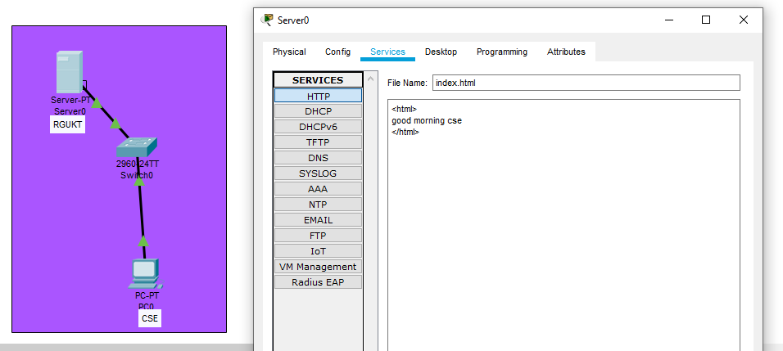
Add your message

Slide 5
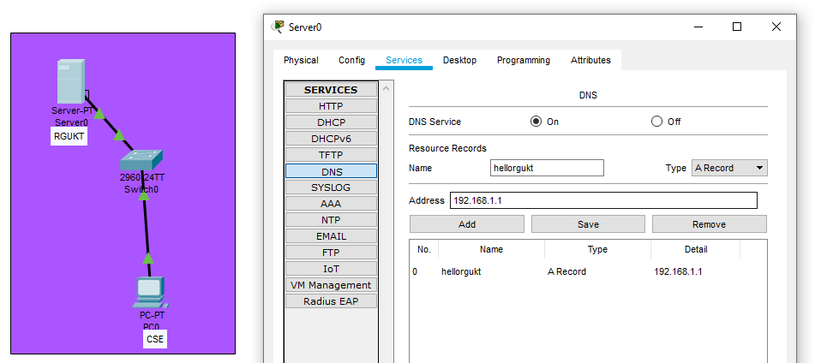
Go to server services select DNS.. put DNS service on and give resource records name and give ip address and click on Add..

Slide 6
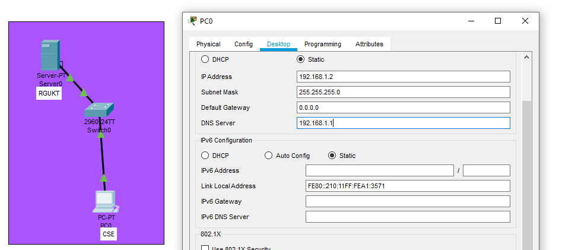
Now go to PC0 and give ip address and set DNS server address

Slide 7
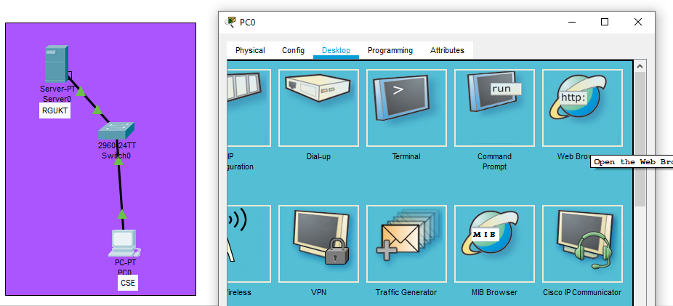
Now in PC0 click on desktop we will find web browser click on it..

Slide 8
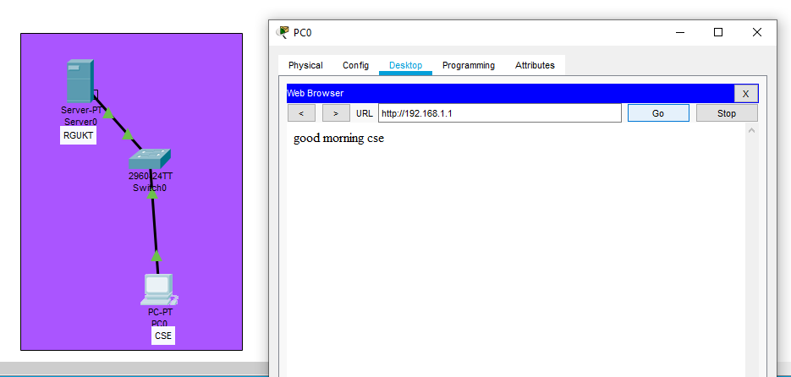
Give the URL address here as you have given and click on GO you will get message …successful DNS config…

